Slide 1
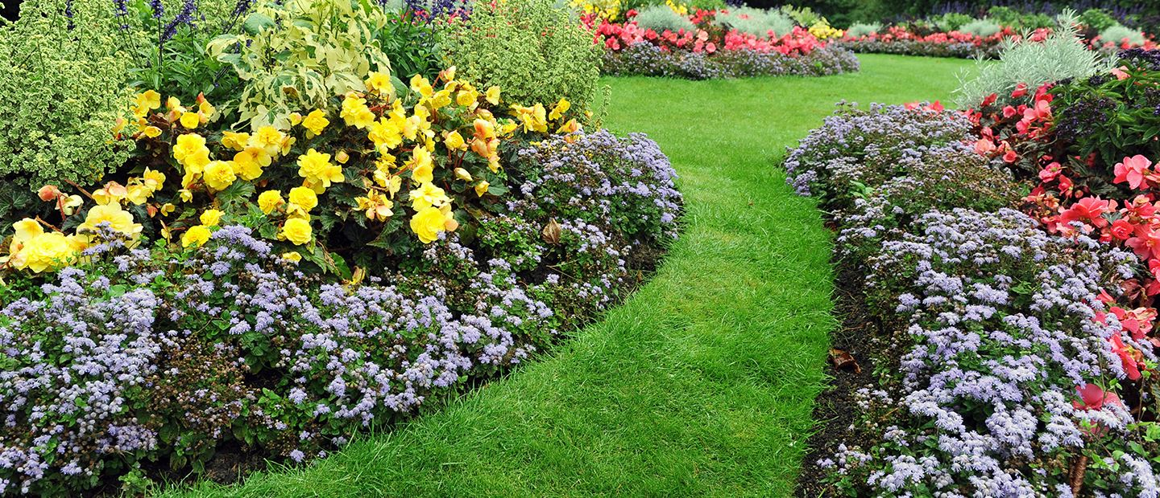
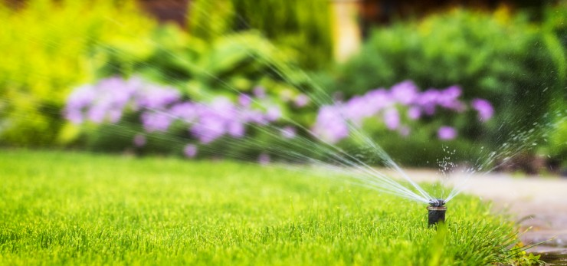

COMPANY
P R OF I L E
GREEN SAFA
F O R G E N E R A L T R A D I N G & C O N T R A C T I N G
C.R.2055131901
Greensafa75@gmail.com

Slide 2

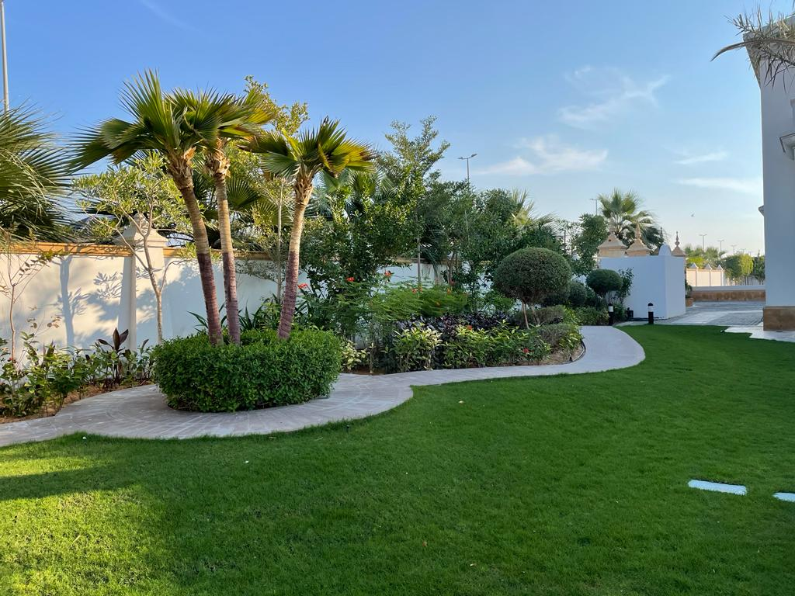
ABOUT OUR COMPANY
Green Safa is Saudi individual establishment it was founded in the year 2019 by a group of engineers & technical experts who are seniors with vast experiences.
Green Safa is a contracting company that provides the finest and most uniquely designed landscaping and design services. We have experienced staff that are highly capable of completing the landscaping projects of any size or complexity. As a professionally trained Landscape Contractor and Irrigation Contractor GREEN SAFA provides one of the finest services. Specialized services in the field design & construction of Irrigation & Landscape & Hardscape works, instrumentation, mechanical, water and sewer systems and Asphalt works .

Slide 3
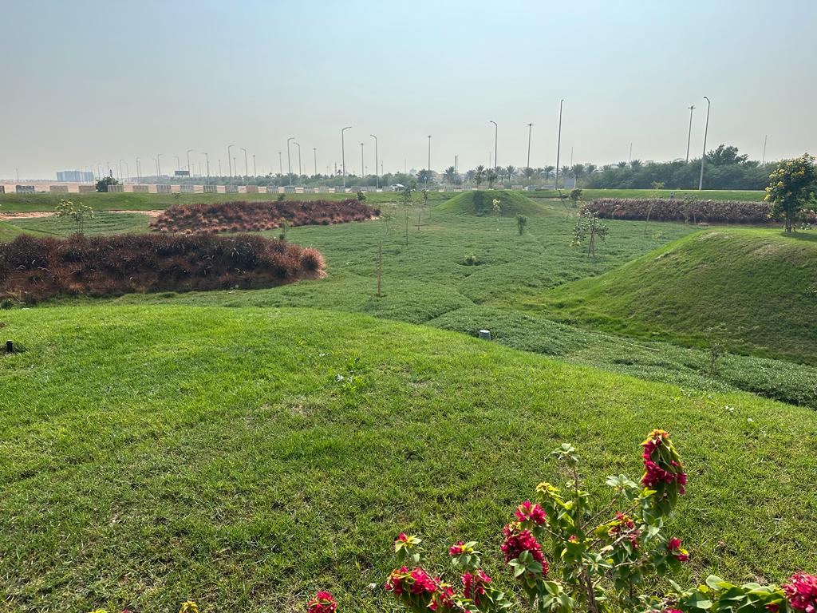
MORE
ABOUT OUR SERVICES
GREEN SAFA
Products including Plant Nursery, Supply of Plants and Supply of Trees for adding value to your desired landscaping project. Substantially, from Hard-Landscaping to Soft-Landscaping, Depending upon the client’s needs, Landscape & Irrigation Department of GREEN SAFA is a creative source for complete landscape designing and quality installation services.

Slide 4
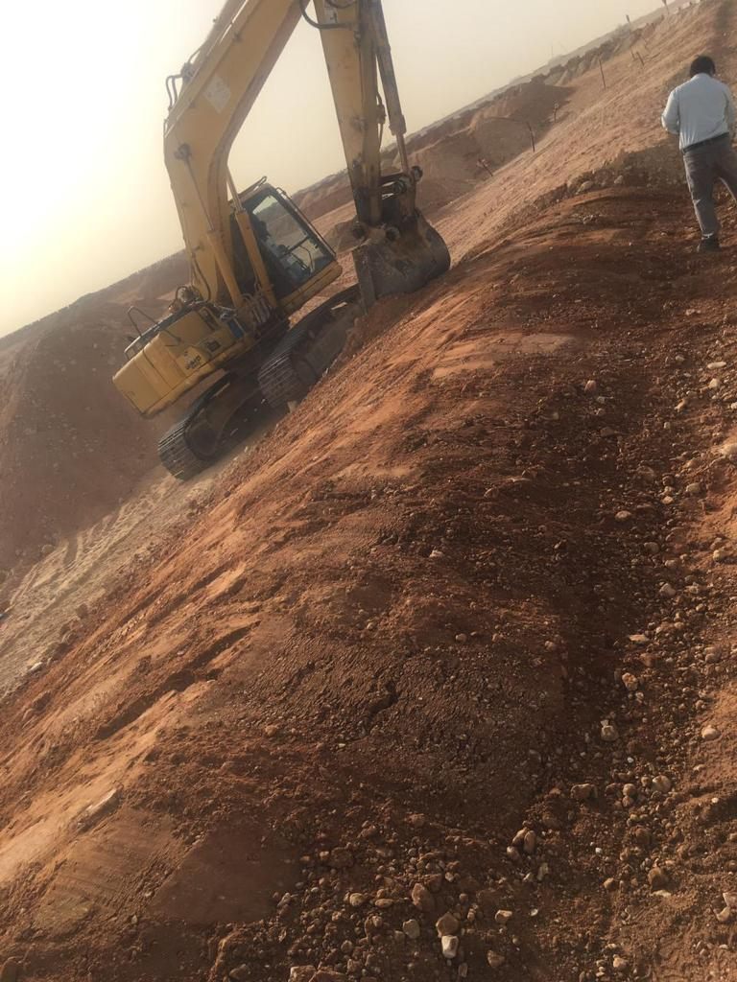
OUR VISION
The company will be the most successful in the domestic contracting.
OUR MISSION
Provide services in the field of contracting to the fullest and according to Standards, work with continuous development and upgrading the company to a global level.
OUR GOALS
Customer Satisfaction
We know very well that work satisfaction is the basis of successful work and in order to get the customer's satisfaction, we provide compatibility needs and support in achieving objectives of integrated solutions.
Employee Satisfaction
We will work continuously to raise the level of job satisfaction for our employees with emphasis on motivating, training, development, create a balance between their work and personal life
Quality
We follow the highest quality standards and work hard for the continuous improvement of performance in everything we do and so that our clients and our staff to achieve added value.

Slide 5
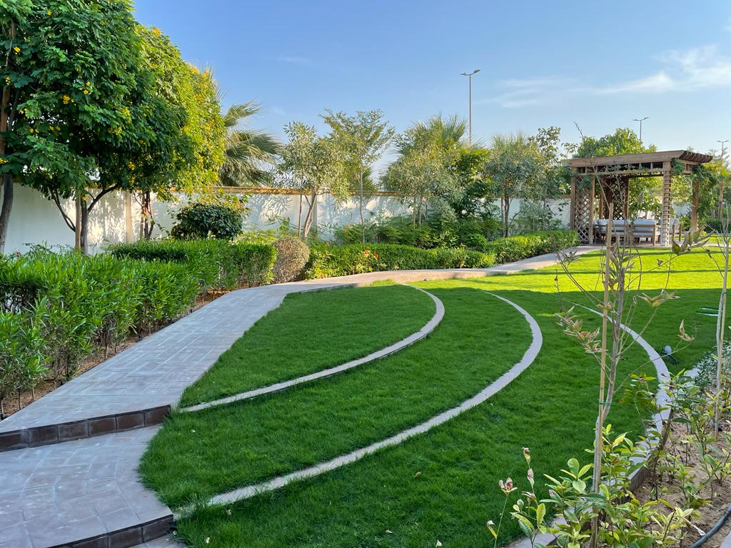

QUALITY POLICY
The aim of our quality management is to ensure that:
We deliver quality service to maintain excellent client relations.
Client satisfaction remains inherent to our business.
Our customer's requirements have been fully understood and met.
All work is carried out consistently to a defined standard. We have the skills and resources to fulfill our customer requirements.
Our staff are fully trained and involved in quality improvement.
We strive to continuously improve our systems and procedures.
We only use services that meet our own quality assurance standards.
A professional approach to customer interface is maintained at all times.
Any complaints are dealt with efficiently and within an acceptable time period.

Slide 6
HEALTH & SAFETY SYSTEM
To GREEN SAFA, safety is a team effort. We believe that accident prevention is the responsibility of all employees. Preventing accidents shall be a primary consideration in all phases of our operations and administration. It is our intention as a company to provide a safe and healthy workplace. This Company will establish and insist upon safe work practices for all employees at all times.
All supervisors must make employee safety an integral part of their management duties. Each employee must accept and follow all established safety, loss control, and risk management regulations and procedures.
This Company believes that safety starts with proper training.
We are providing continuous training to all of our employees.
Employees must help to prevent accidents. Unsafe conditions must be reported immediately.
If an employee is not sure of how to perform a task safely, he should ask a qualified person for guidance or help. If someone needs help to perform a task safely we will provide assistance.

Slide 7
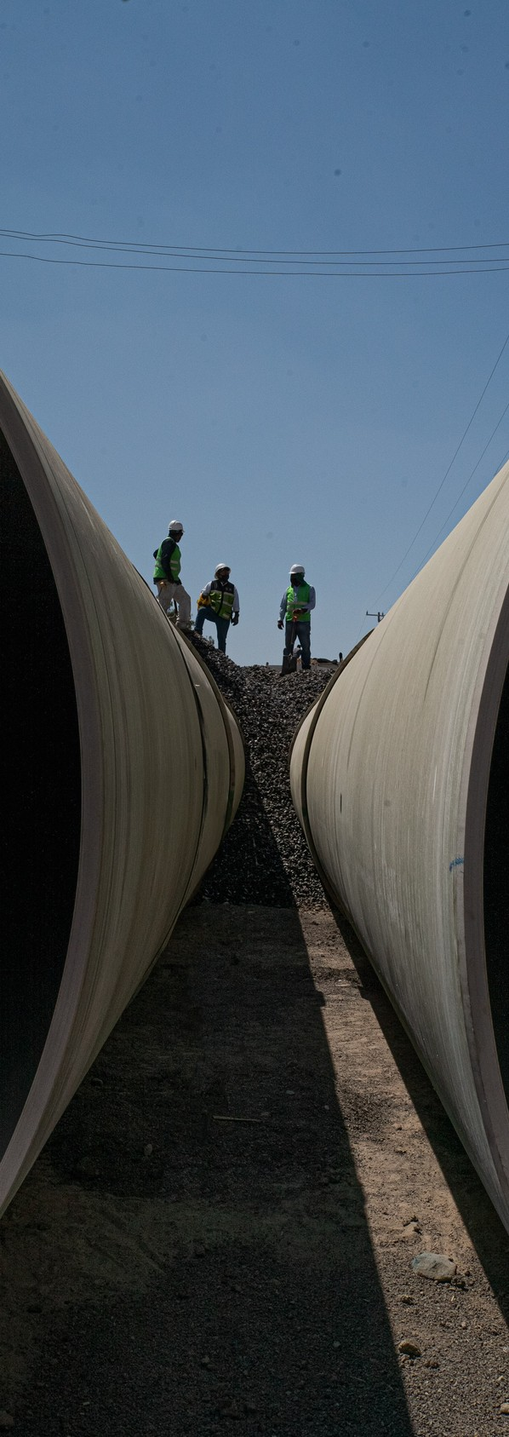
Every injury reported
must be immediately.
Even a slight cut or strain
injury must be immediately.
reported Accidents
and injuries reported
must be immediately.
Accidents and injuries must be reported to your supervisor, management, or safety officer immediately.
Serious require medical
injuries that
emergency care must be
reported to management immediately after emergency care has been provided.
All accidents will be thoroughly
investigated. Employees cooperate management
must with during
any accident or injury investigation.
All employees are reminded to work safe.

Slide 8
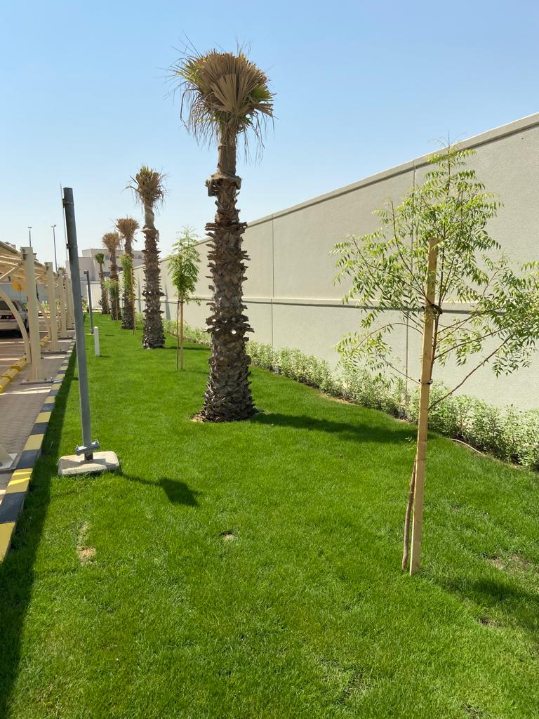
EXECUTIVE
MANAGER'S MESSAGE
" E F F E C T I V E L Y T O T H E
R E V I V A L A ND D E V E L O P ME NT O F NA T I O NS ,
this sector plays an important role in the construction, advancement, and growth of emerging economies and the provision of a sound infrastructure for all services.
In 2019, green safa , contributed to the growth of the economy on the basis of quality and efficiency. Our company also contributed to filling the gap in a local contractor's needs in order to give a solution to the sector's increasing impediments.
Our company strives to be successful in developing both special projects and other aspects of our business. This goal stems from the company's values and objectives, which were imprinted in this entity when it was established.
In maintaining our performance level, we aim to complete the work based on operational efficiency and quality by having a clear vision in raising the local and international standards, which allows us to get higher rankings, God willing.

Slide 9
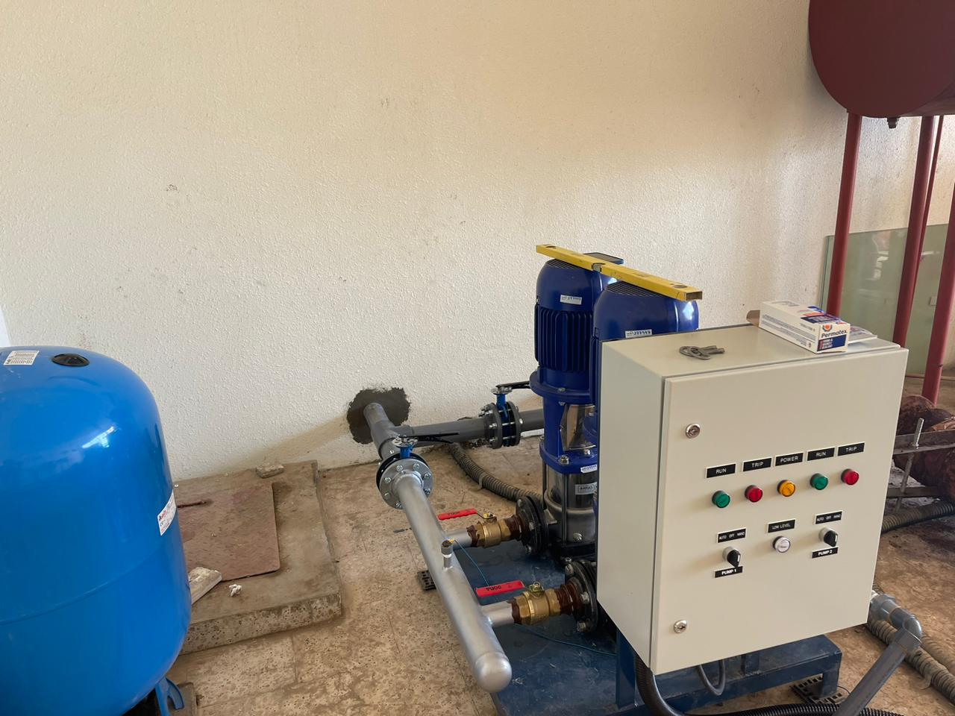
SERVICES
GREEN SAFA , with its highly qualified engineering, manpower, and inspection team, offers our clients complete integrated services in all engineering activities and scopes, our main divisions and services are divided into:
IRRIGATION & LANDSCAPE
HARDSCAPE ACTIVITIES
WATER & SWEAR
In that main categories, we commit to adhere the high-quality procedures that ensure the highest-quality procedures that ensure the highest level of satisfaction to our clients, under each division green safa provides all dedicated services as follows:
CIVIL CONSTRUCTION DIVISION
Since GREEN SAFA was established, we have got good standing and reputation for the execution of all civil construction-related work:
ASPHALT WORKS
CONSTRUCTION

Slide 10
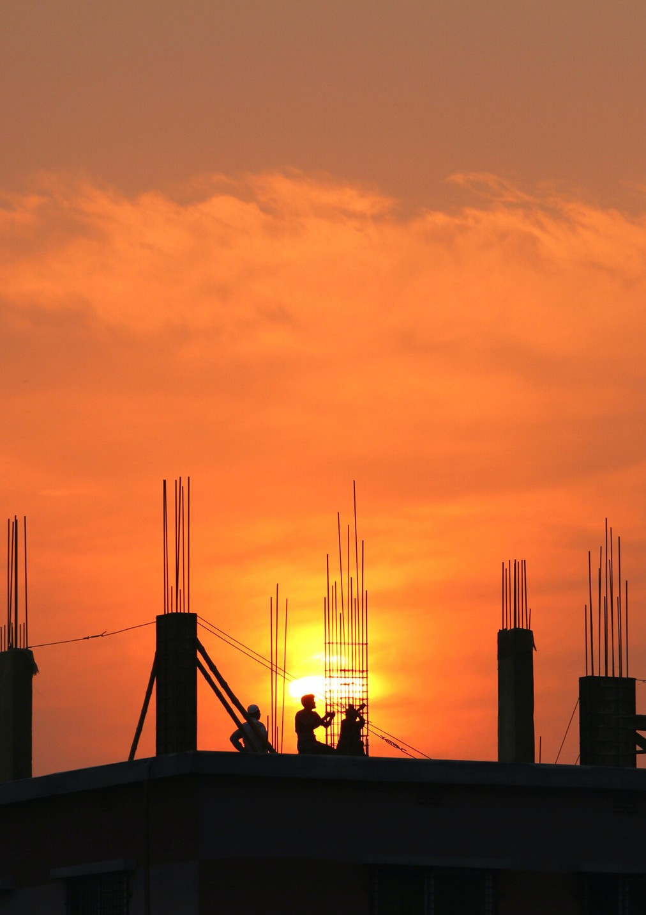
GOVERNMENT DOCUMENTS

Slide 11
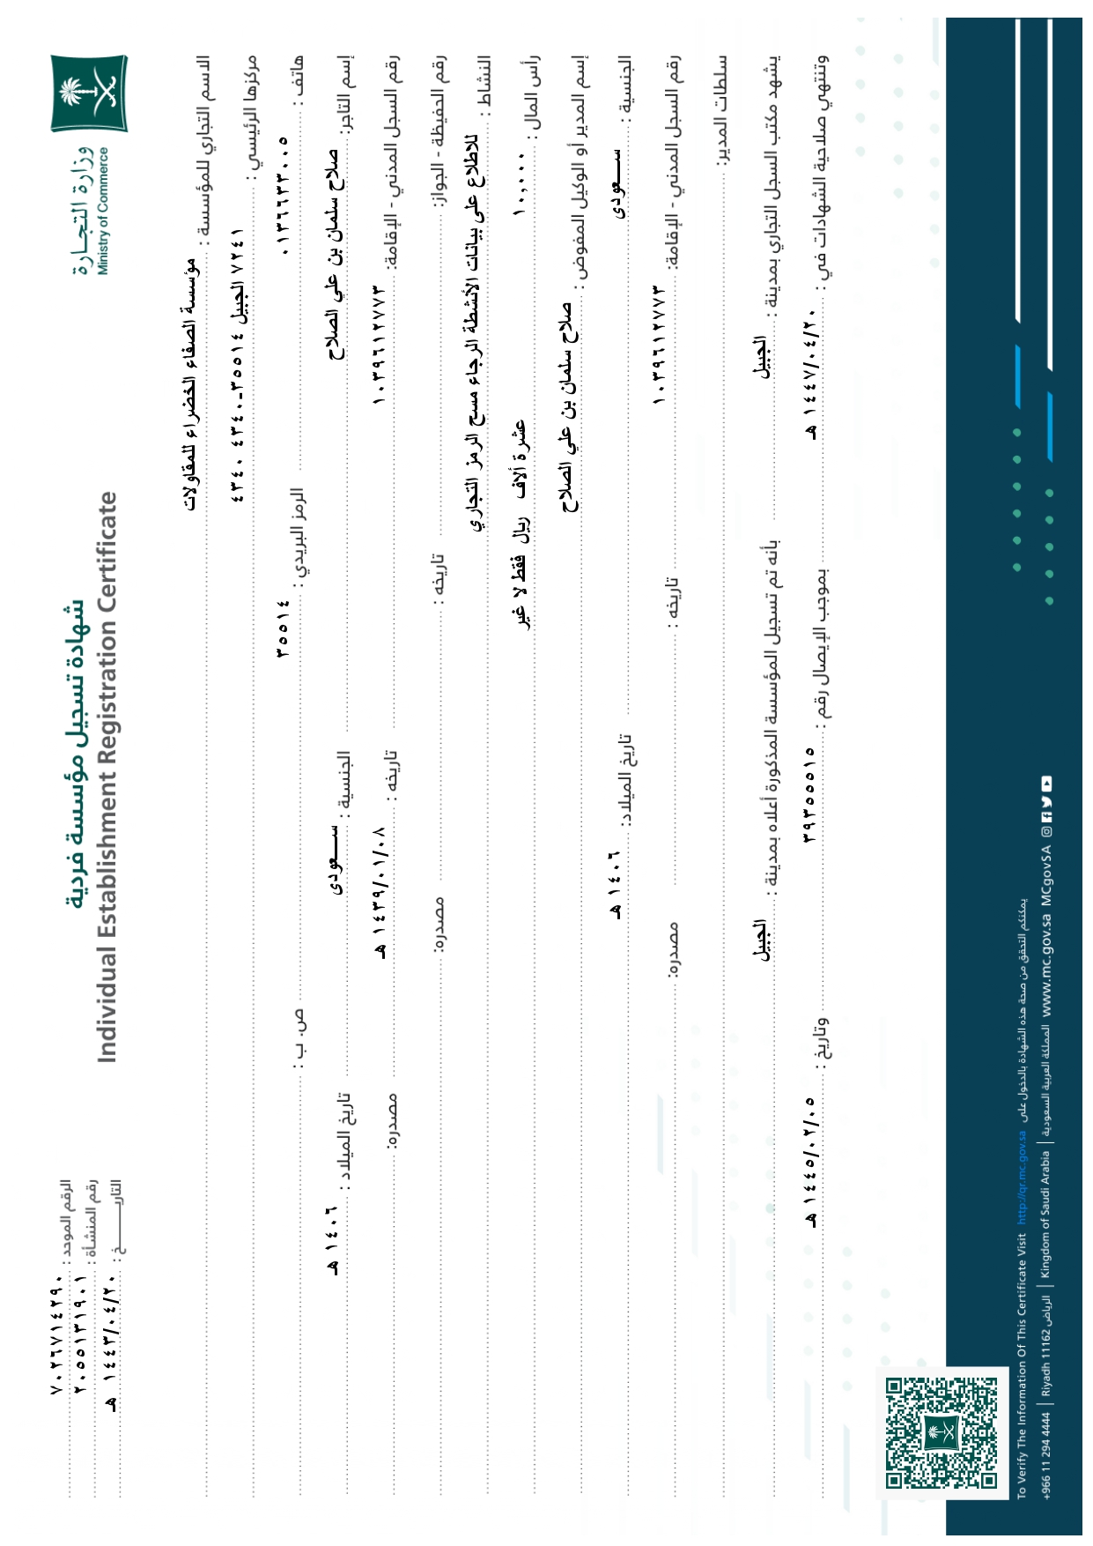

Slide 12
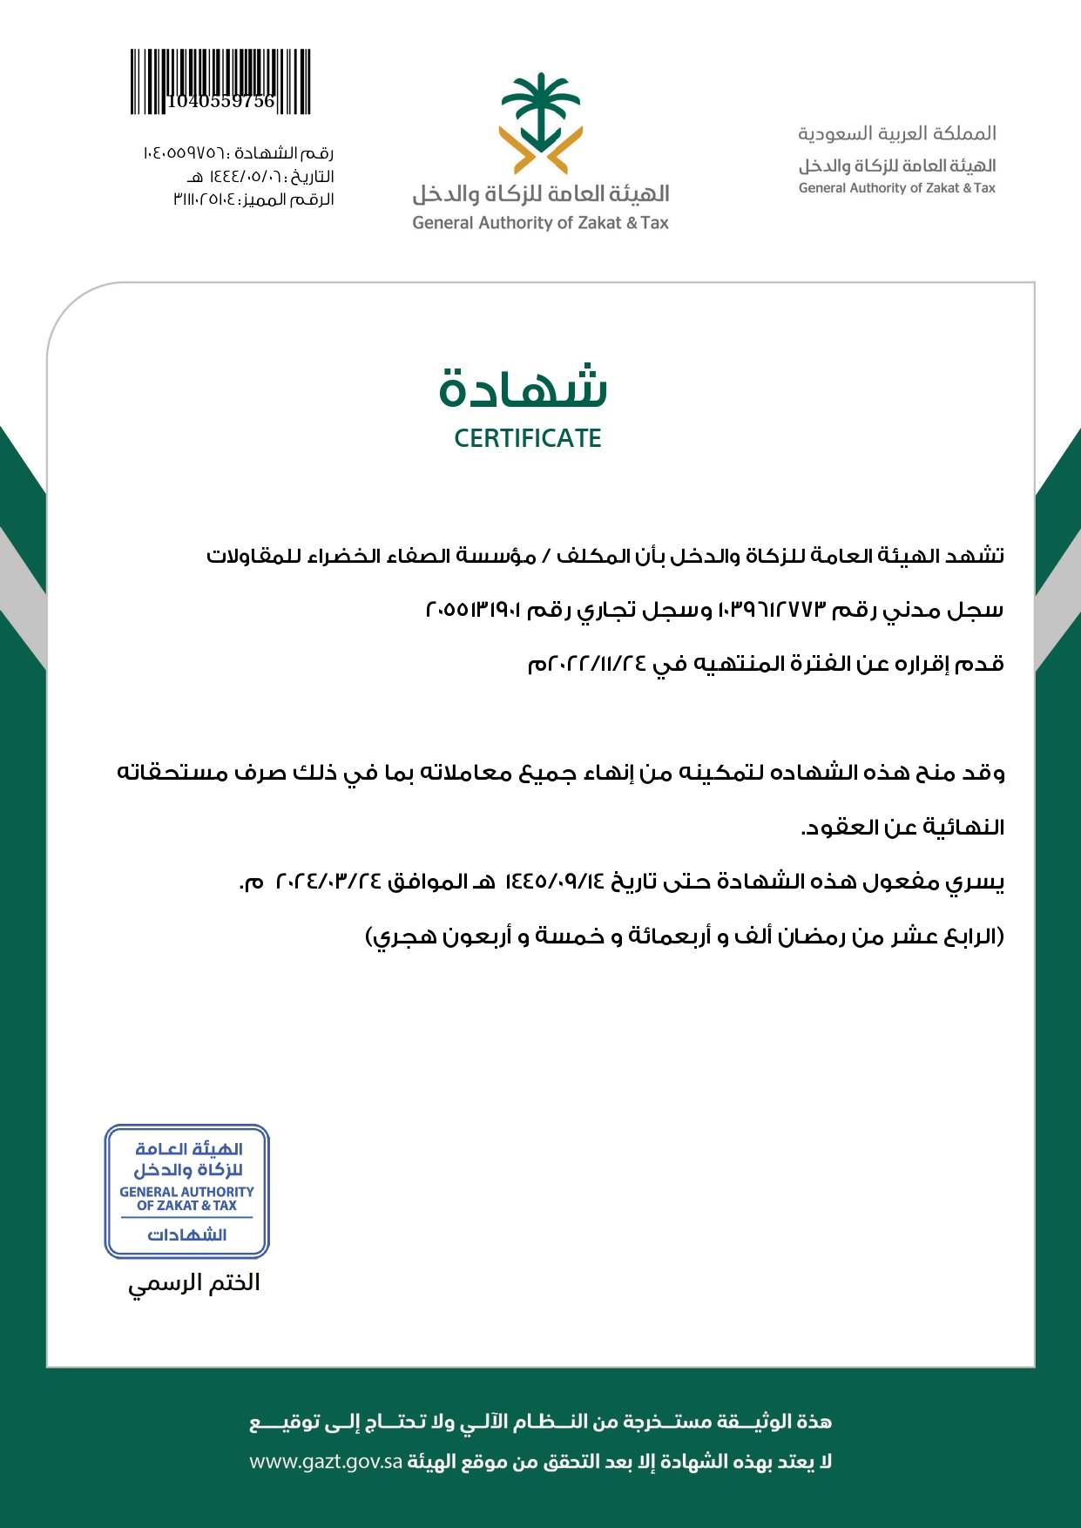

Slide 13


Slide 14


Slide 15
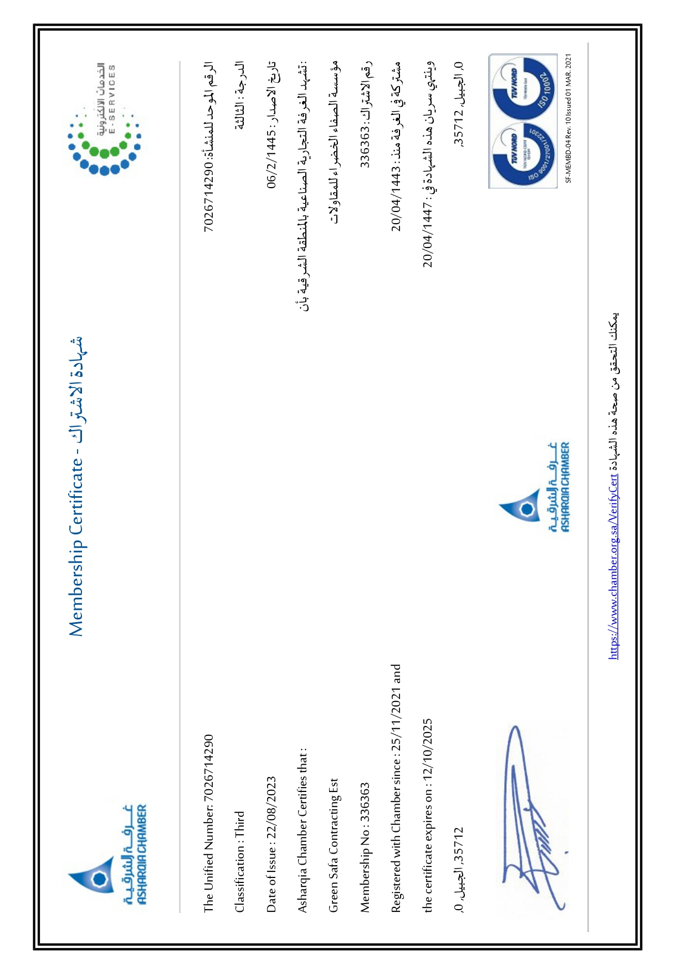

Slide 16
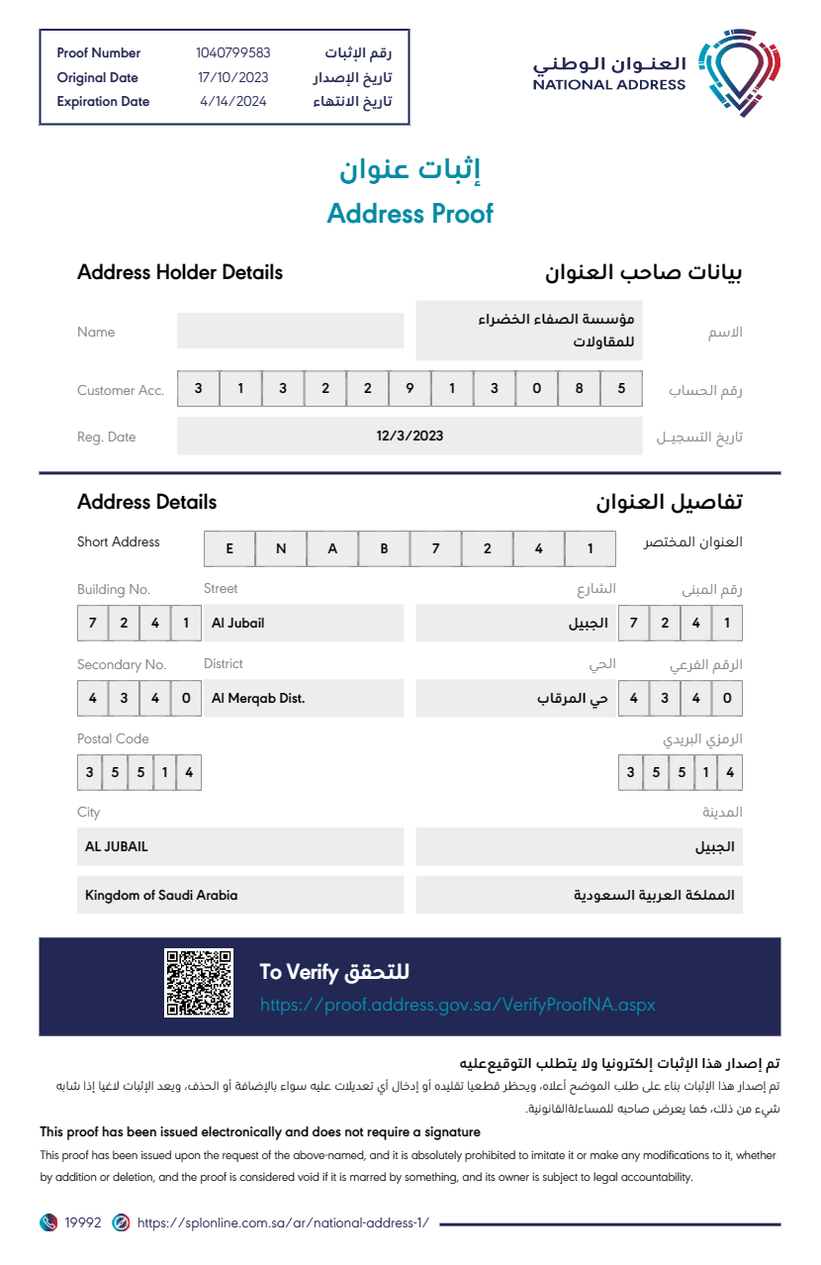

Slide 17


Slide 18
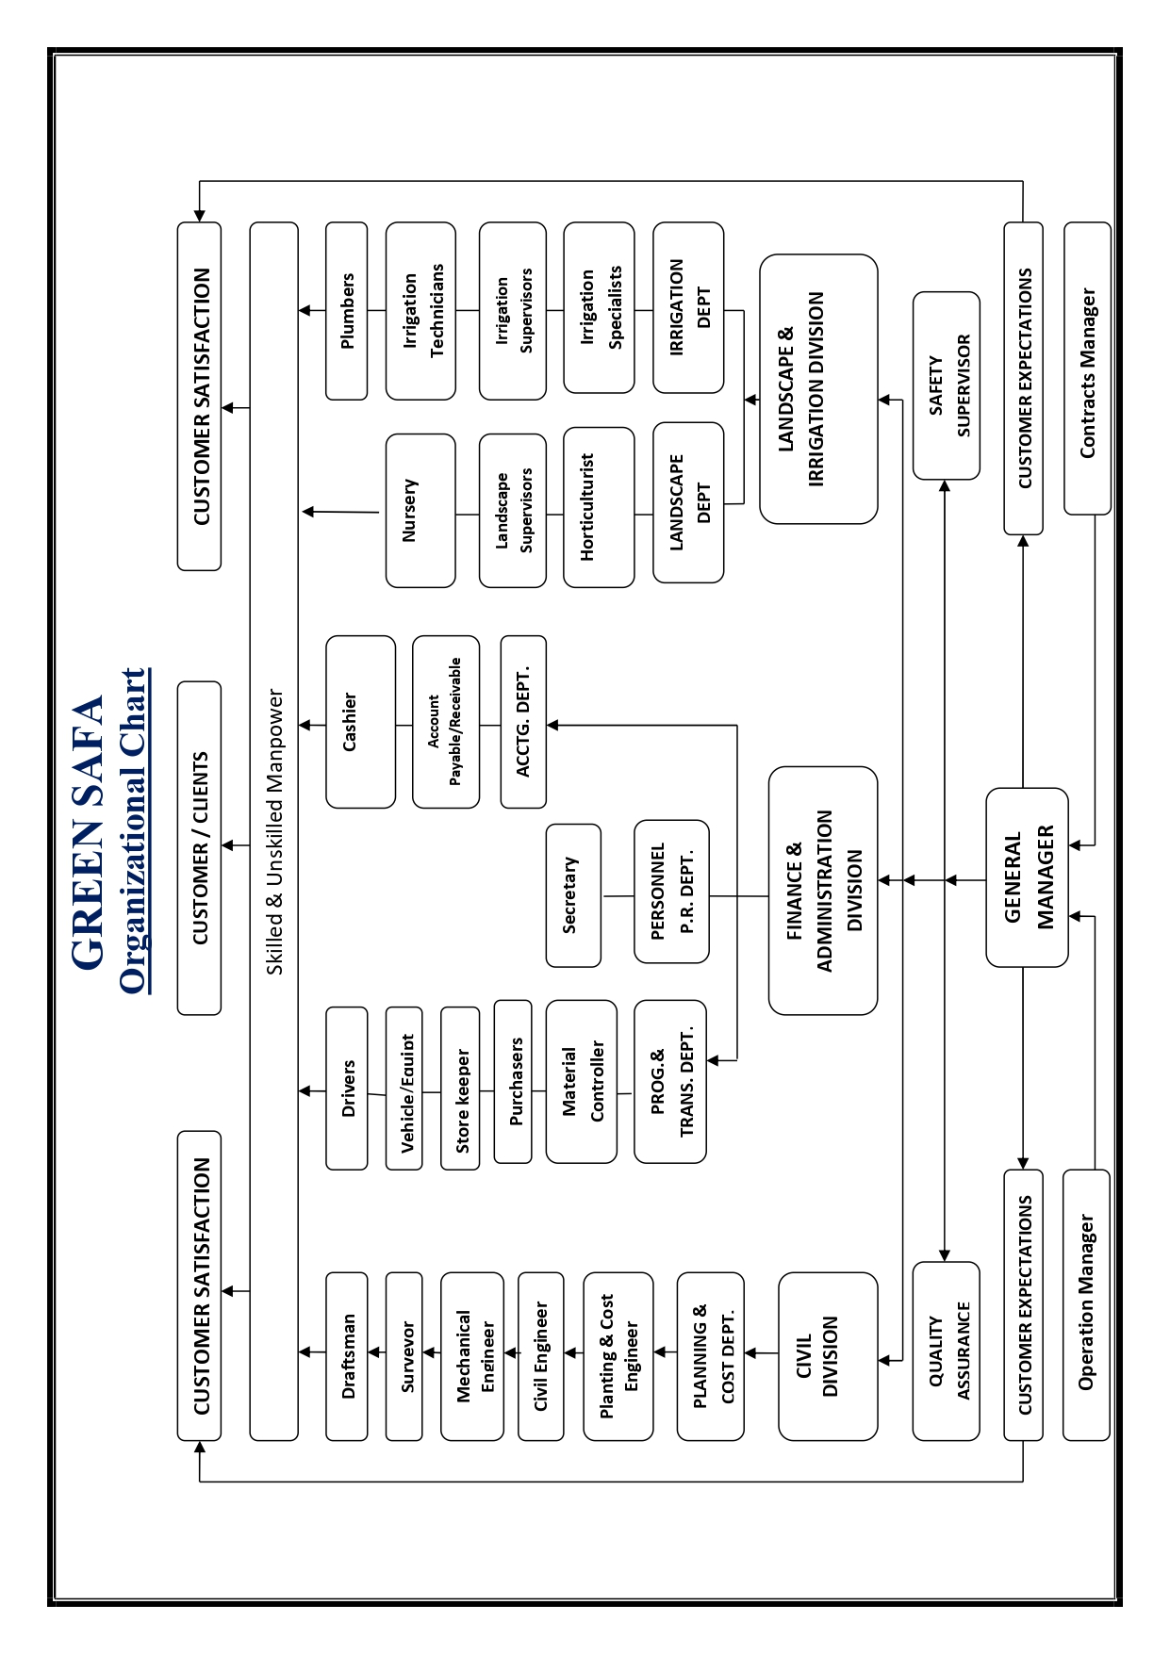

Slide 19
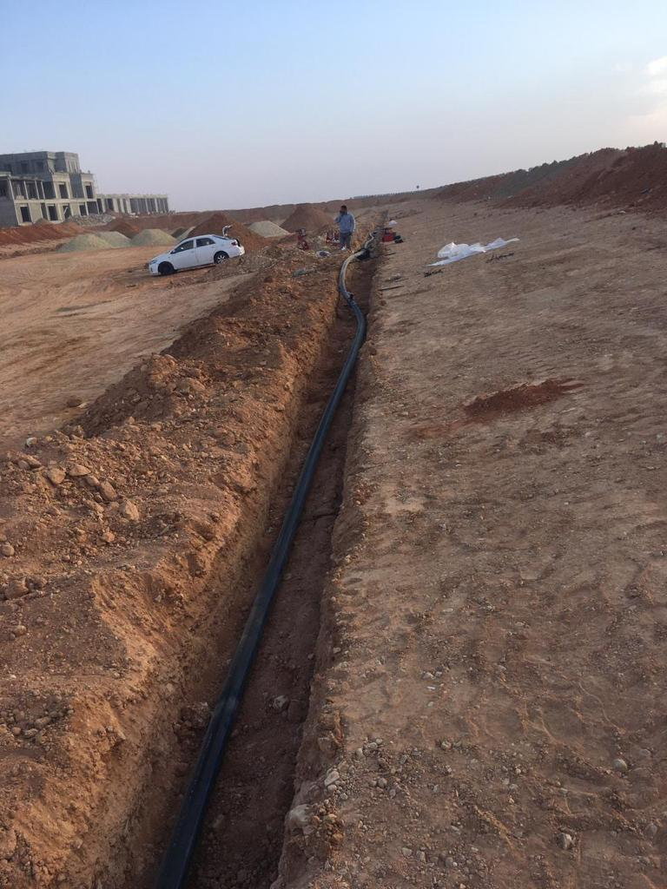
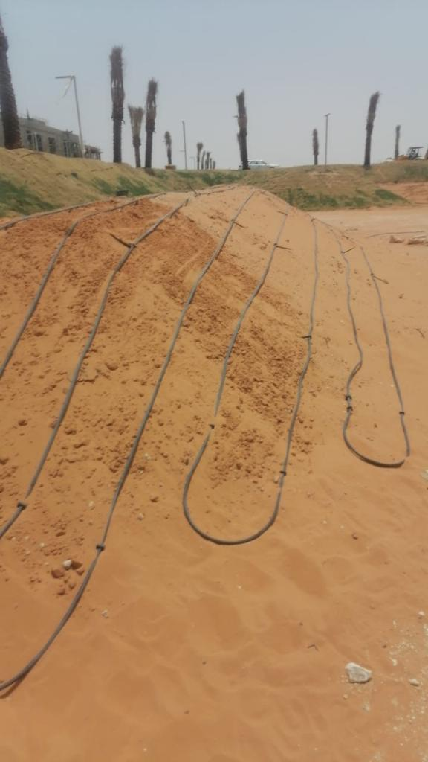
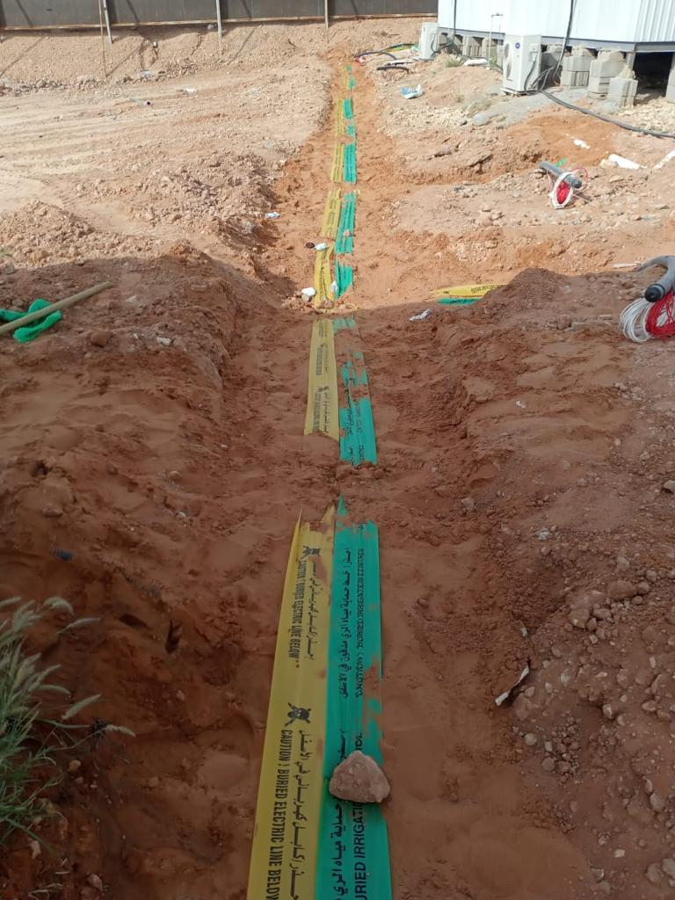
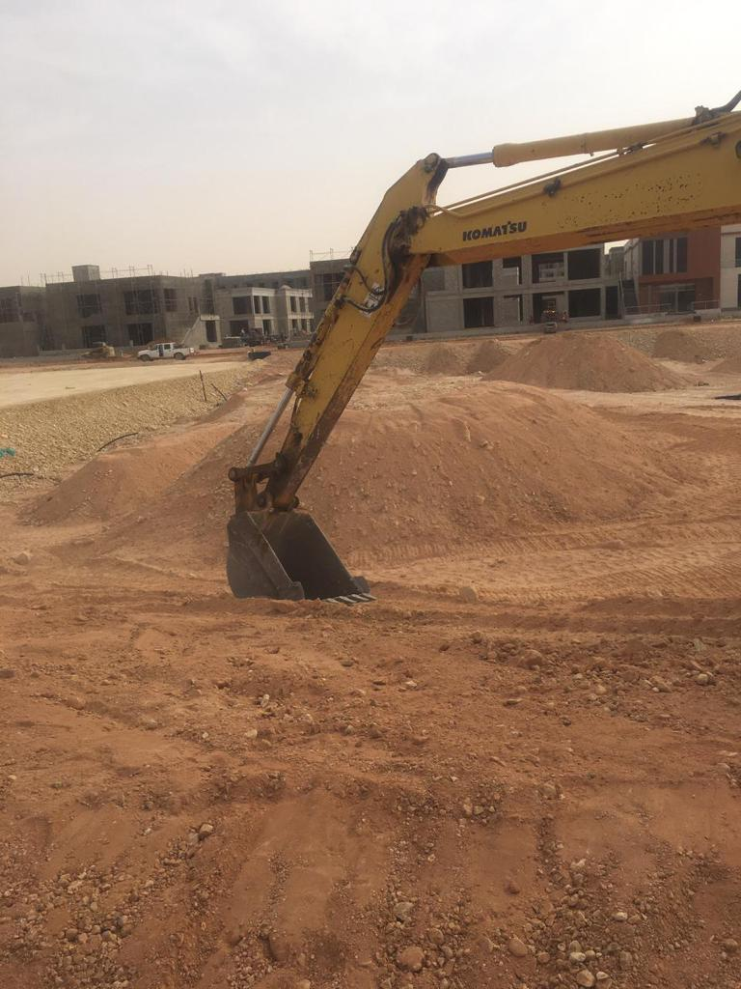
PROJECTS

Slide 20
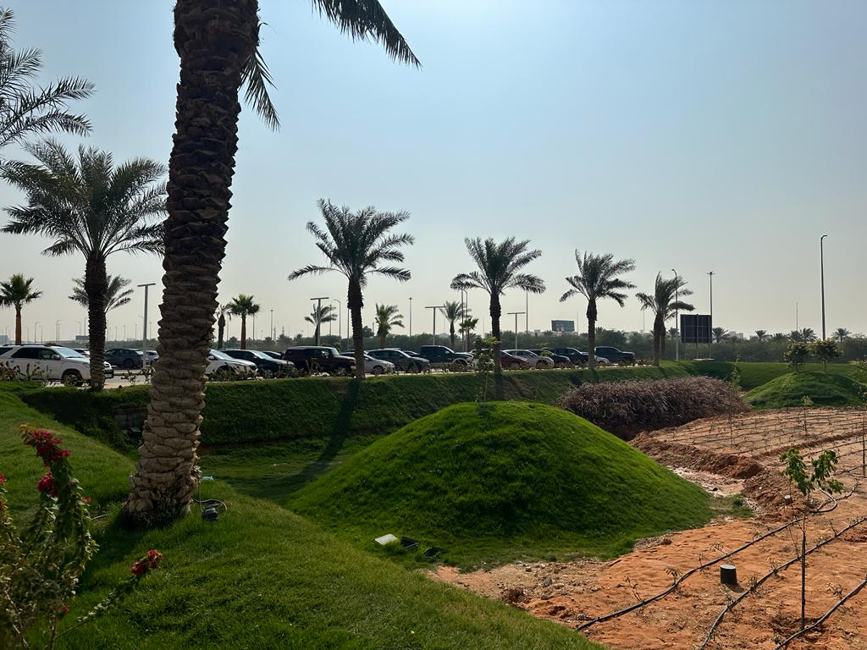
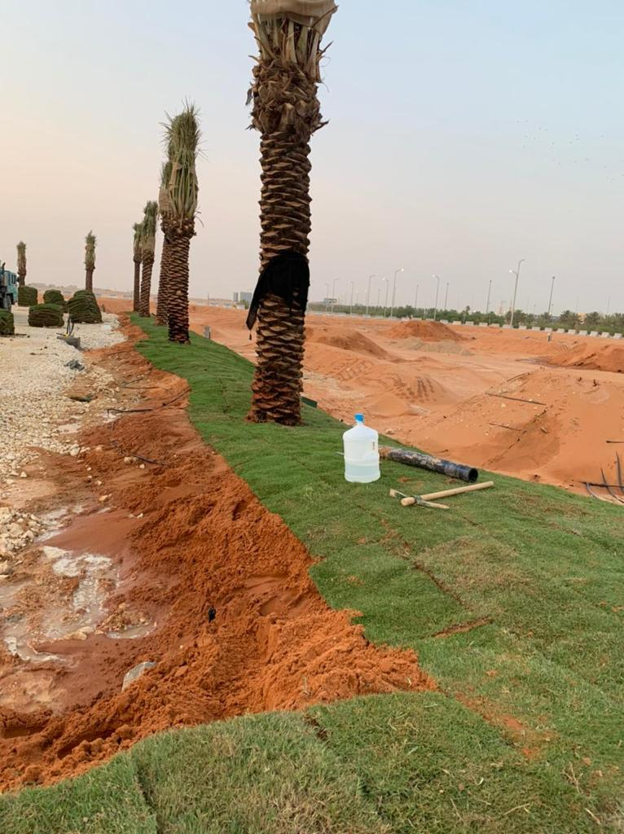
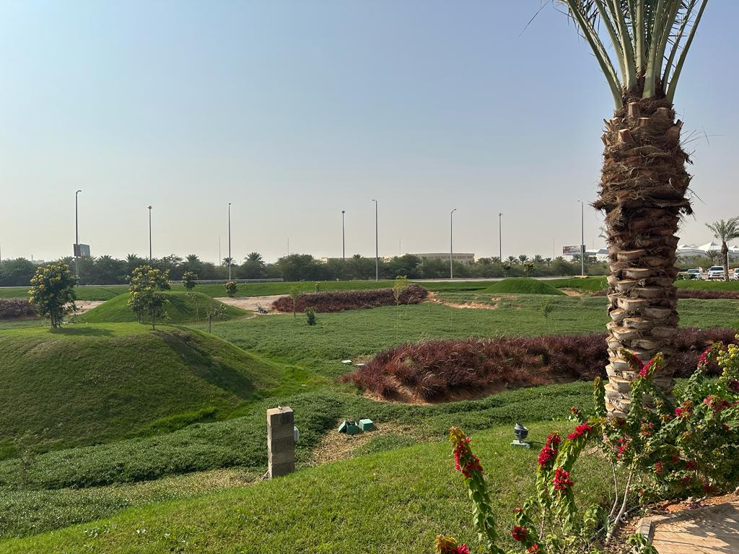
PROJECTS

Slide 21
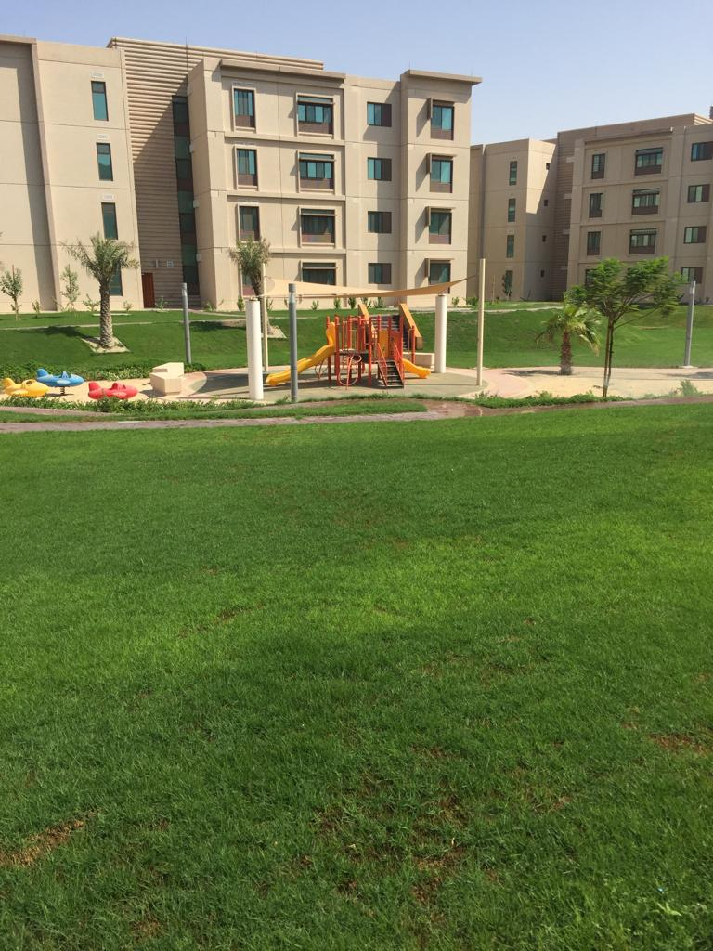
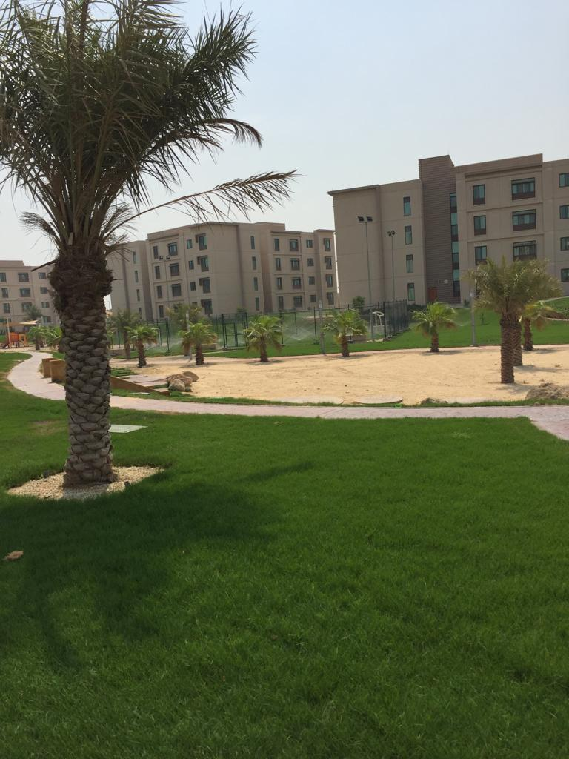
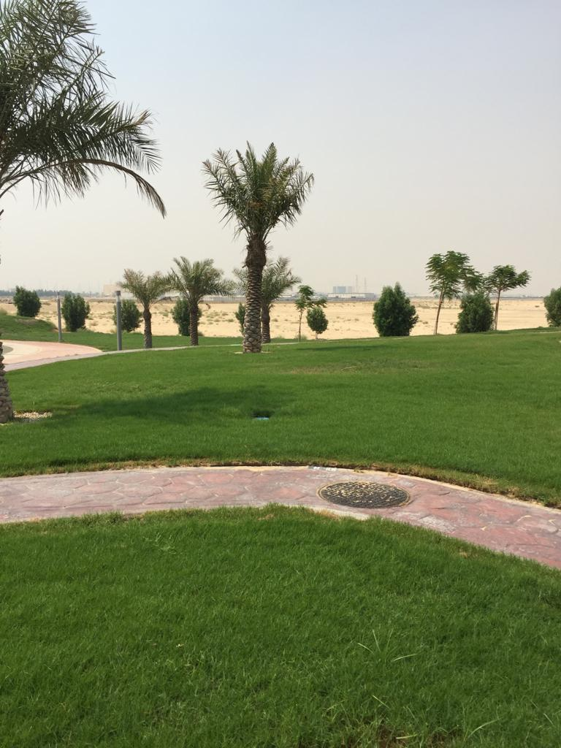
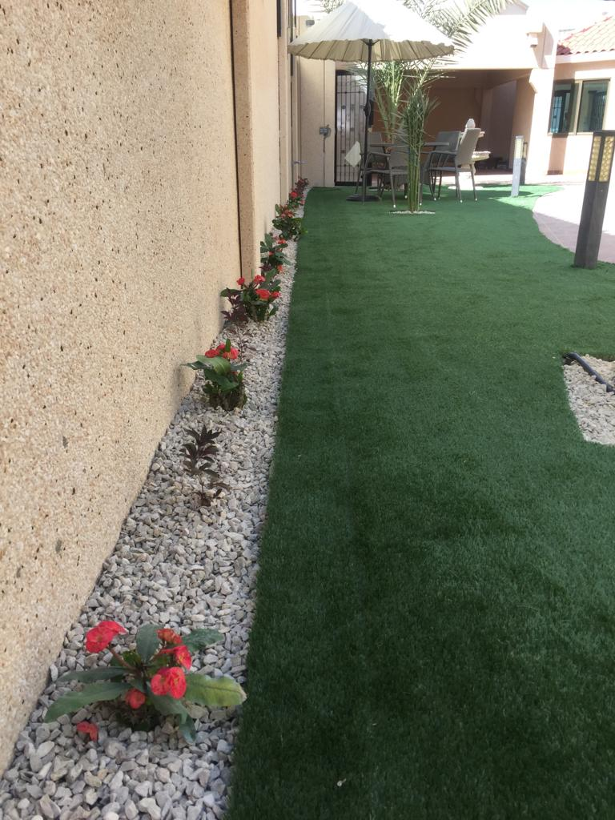
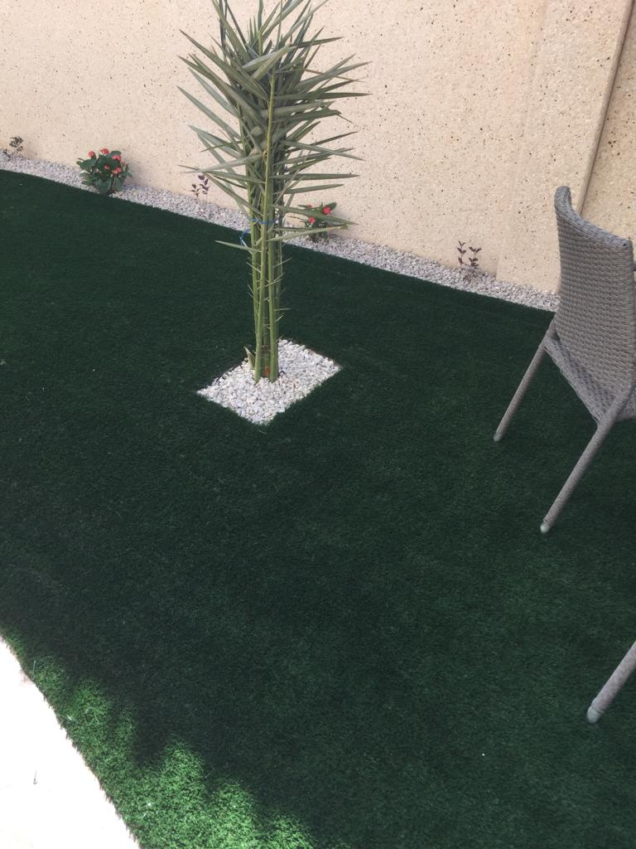
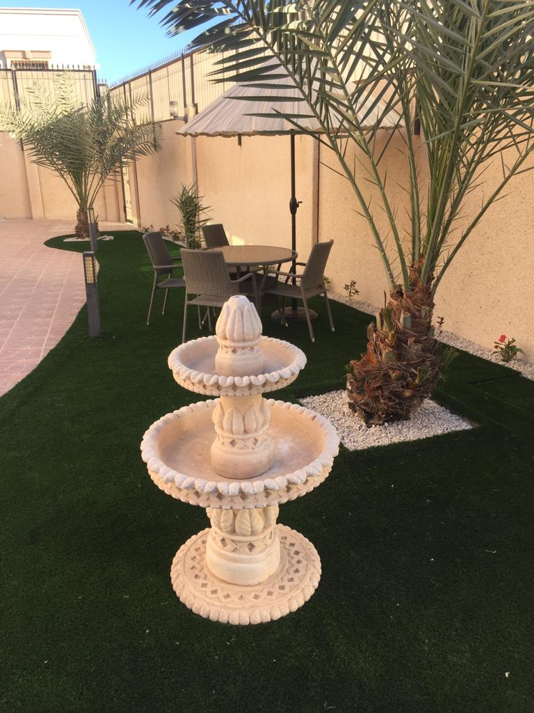
PROJECTS

Slide 22
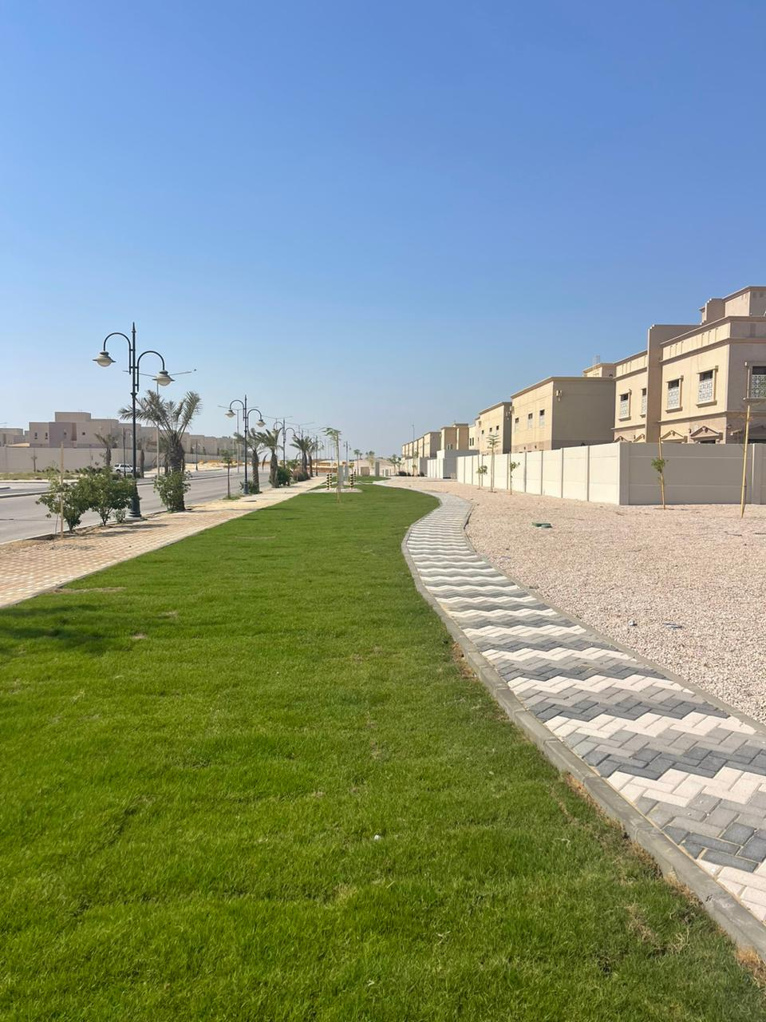
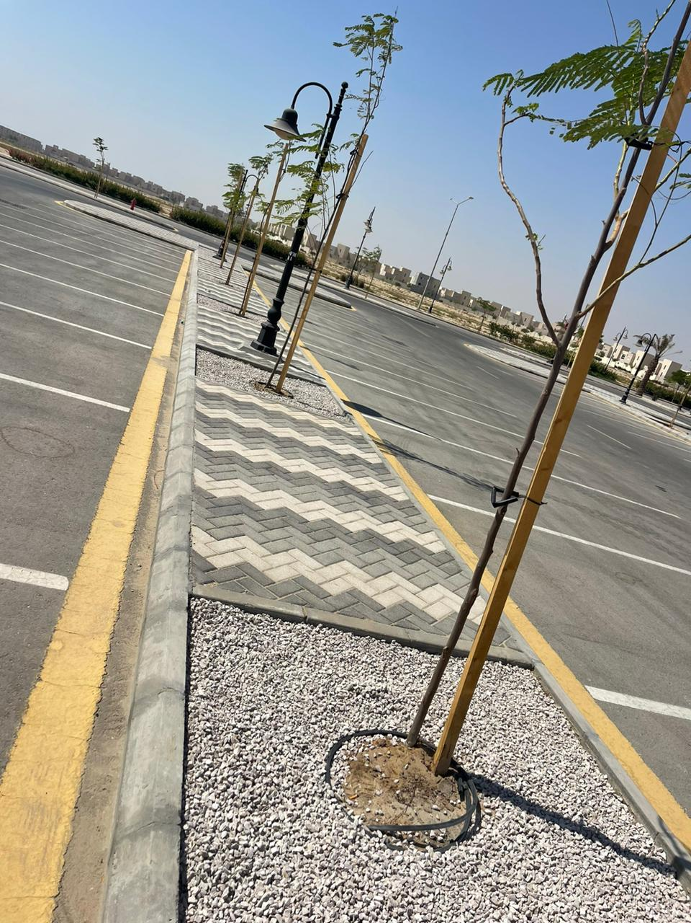
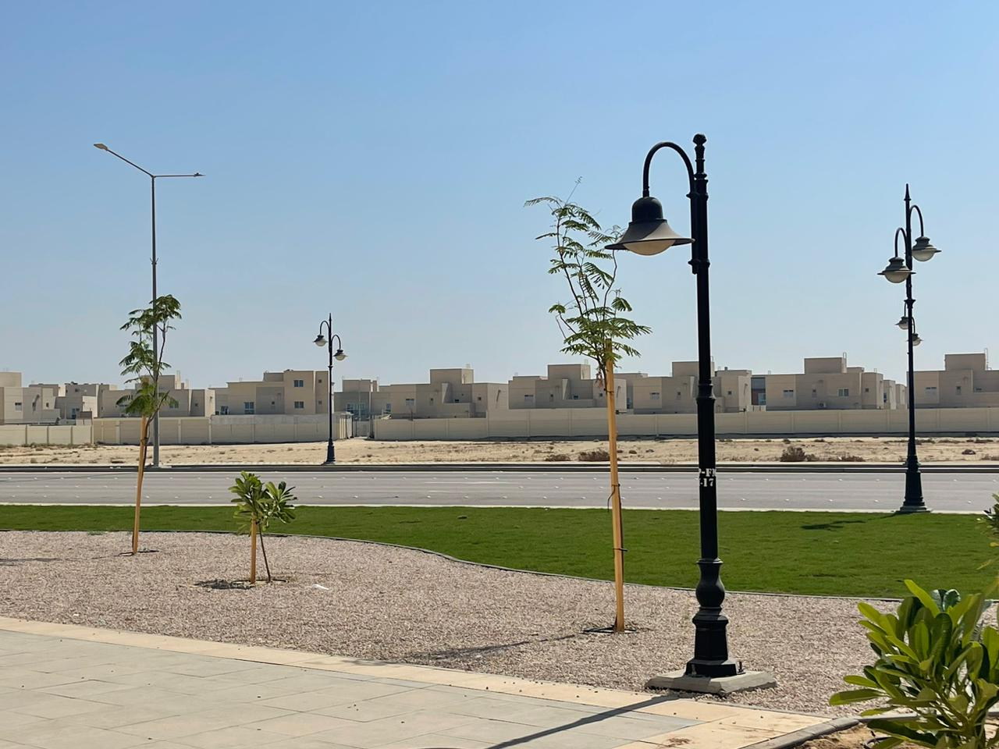
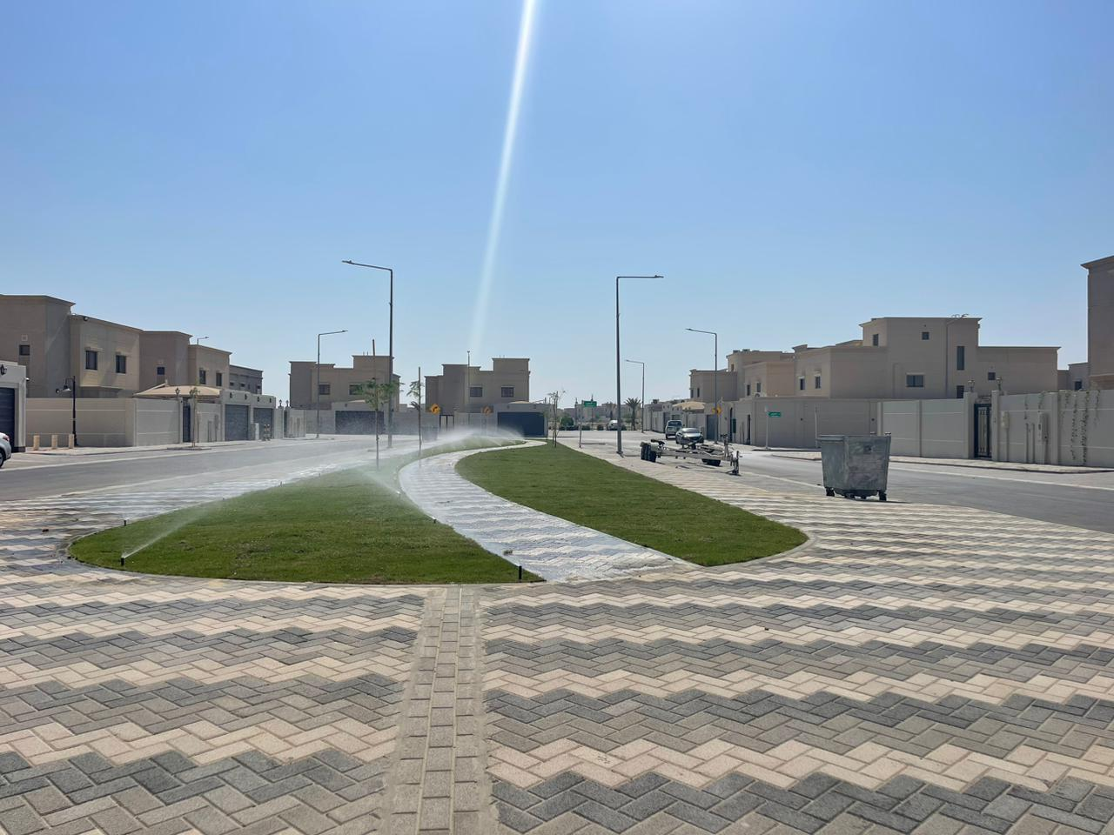
PROJECTS

Slide 23
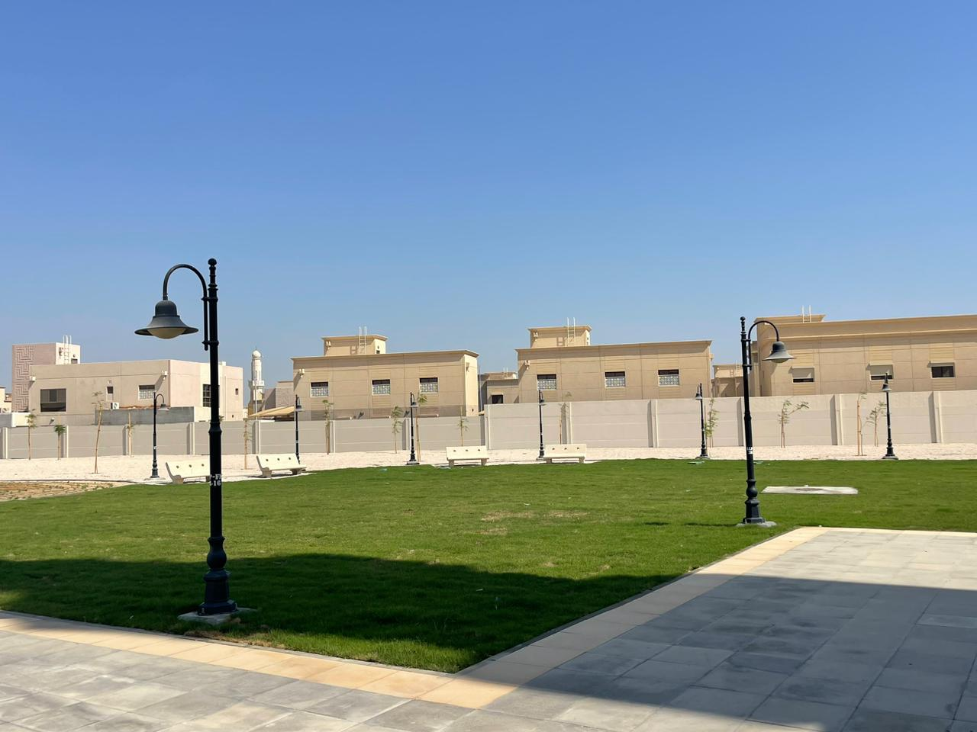
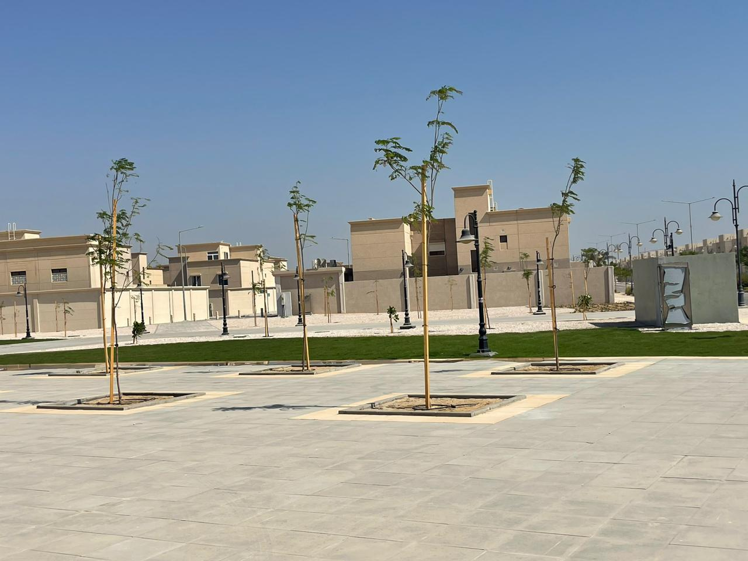
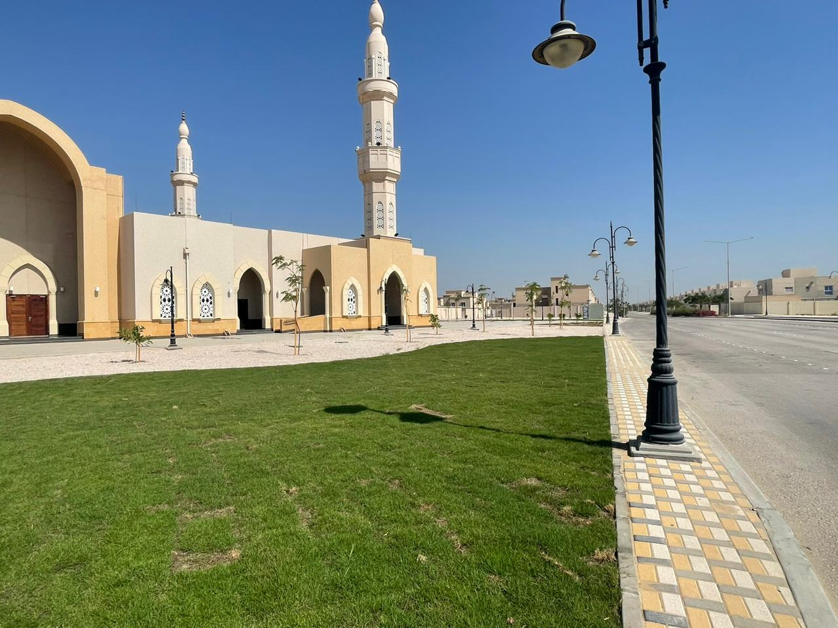
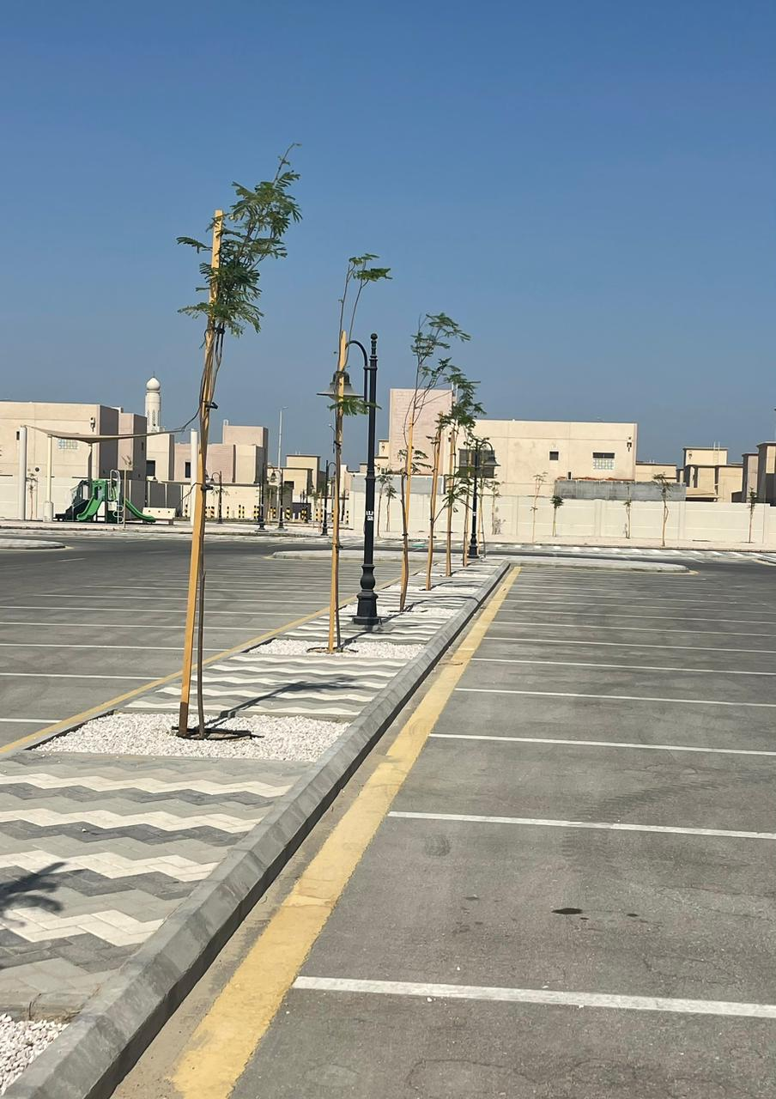
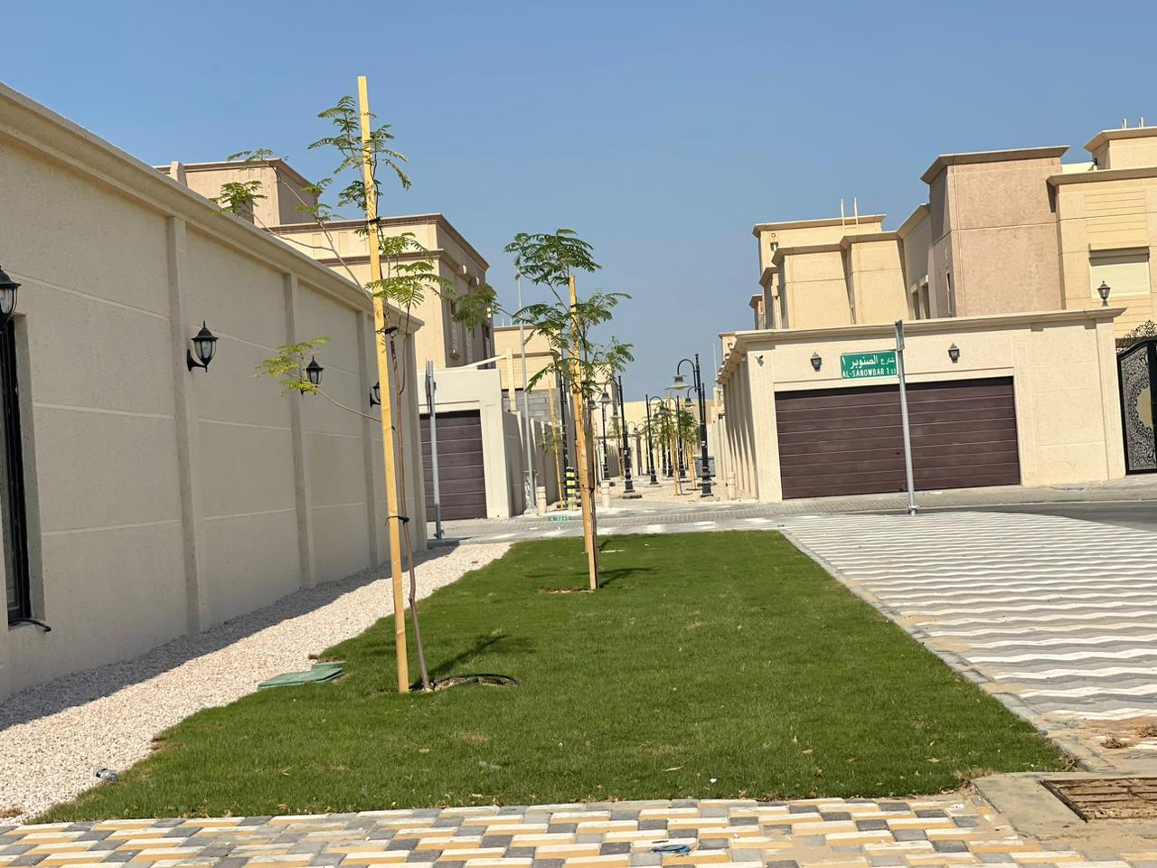
PROJECTS

Slide 24
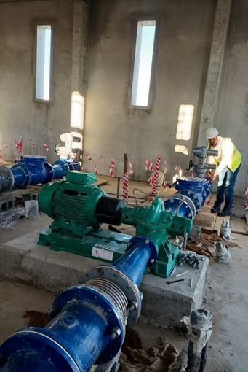
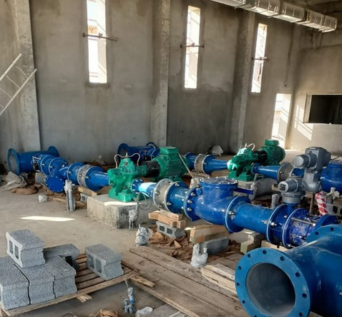
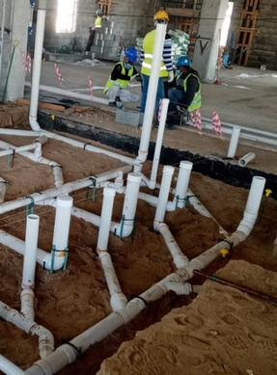
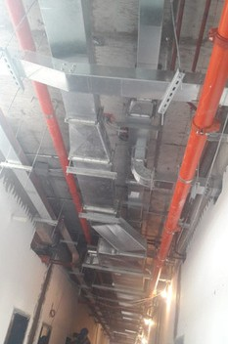
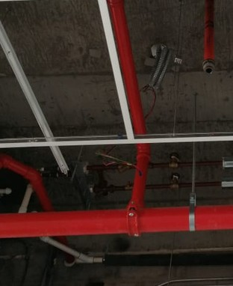
PROJECTS

Slide 25
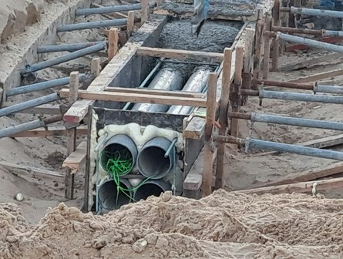
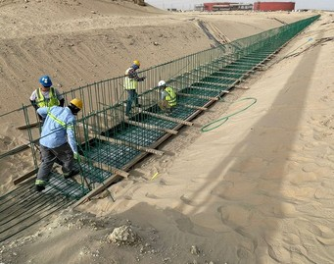
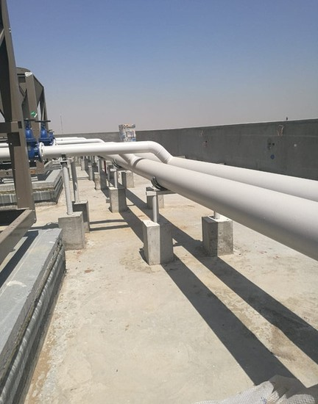
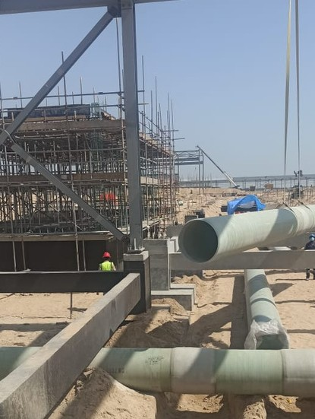
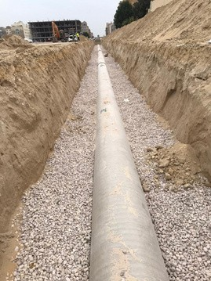
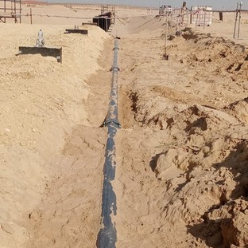
PROJECTS

Slide 26
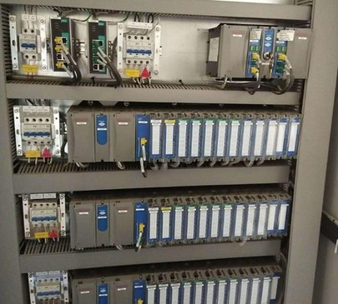
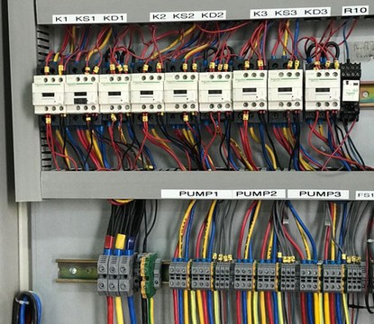



PROJECTS

Slide 27





PROJECTS

Slide 28




PROJECTS

Slide 29




PROJECTS

Slide 30





PROJECTS

Slide 31




PROJECTS

Slide 32




PROJECTS

Slide 33






PROJECTS

Slide 34





GREEN SAFA
FOR GE NE R AL CONT R ACT I NG
CONTACT US
Jubail ,Prince Naif Road Kingdom of Saudi Arabia 00966 581771751
00966 590404688
00966 559514165
greensafa75@gmail.com

